Slide 1


FINANCIAL STOCK MARKET REPORT
FOR DATALEUM HACKATHON
4.0 EDITION.
PRESENTED BY:
ODUMERU ADEOLA JULIET
SEPTEMBER 15, 2024

Slide 2

CONTENTS
01
INTRODUCTION TO THE STATEMENT
02
DATA ANALYSIS REPORT
03
RECOMMENDATION
04
CONCLUSION

Slide 3


OVERVIEW
BUSSINESS PROBLEM STATEMENT
As a Data Analyst the task is to conduct a comprehensive analysis and visualization of financial stock market price for various companies stock listed across the sector. the sector Includes Health, Telecommunications, Industrial, Real Estate, Financials, Energy etc play a major role buying and selling of their capital share.
The financial datasets were made available for analysis; there were some adjustments made during the visualisation process, total stock market records if 505 companies and eleven unique sector entities. A relationship between the fact table and the dimension table was created by creating a fake date in place of the stock market date, after the data had been cleaned and transformed.
The fake date for stock market date begins from Y2022 to Y2024, is crucial depicts the trend pattern of stock market analysis.
The primary goals is to explore relationship and correlation among the key indication variable like High, Price , Price/Earning, Earning/Share, Market Capitalization etc.

Slide 4
FINANCIAL STOCK MARKET REPORT
The ability to forecast the stock market has become critical for organizing business operations. Many studies in a range of fields, including operations research, computer science, statistics, economics, and finance, have been motivated by the prediction of stock price. Recent research has demonstrated that the vast amount of publicly accessible online information, including news from the media, social media platforms, and Wikipedia, significantly influences investors' perceptions of the financial markets. Because the stock market is highly sensitive to changes in the economy and can cause financial losses, the accuracy of computer models used to predict it is crucial.
Stock Analysis help traders to gain an insight into the economy , stock market, or securities involving the past and present market data, also includes the identification of ways of entry into and exit from the investment..
Stock Market means equity market or share market is the aggregation of buyer and seller of shock called shares.

Slide 5
FINANCIAL STOCK MARKET REPORT
These may includes securities listed on public stock exchange as well as stock that is only traded privately such as share of private companies.
A financial stock market report is a written or published work that offers a synopsis and evaluation of the financial performance, stock market activity, and overall investment prospects of a company. Usually, it consists of:
Company overview: Overview of the company, its offerings, and its industry.
2. Financial statements: Analysis of the cash flow statement, balance sheet, and income statement.
3. Stock performance: Market capitalization, trading volume, and historical and present stock prices.
4. Valuation metrics: dividend yield, price-to-book (P/B) ratio, and price-to-earnings (P/E) ratio
.5. Growth prospects: Potential growth in revenue, earnings, and cash flow is examined
.6. Risk factors: Explaining possible dangers, difficulties, and ambiguities.

Slide 6
The financial datasets were made available for analysis; there were some adjustments made during the visualisation process, with 505 total stock market records and eleven unique sector, A relationship between the fact table and the dimension table was created by creating a fake date in place of the stock market date, after the data had been cleaned and transformed.
A summary of a financial stock market report typically includes depicts the performance of each 505 companies and the valuation rating like price/earning, price/book.

Slide 7

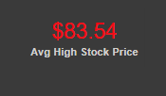
FINANCIAL REPORT
Based on analyse report Low stock price has the average of $122,62 dollar volume, this can occurred due to stock trading market of low price per share compared to its historical average.
The Low stock price has an increase volume, this may be as a result of investors may view a stock price as chance to buy undervalued share across sectors
Based on analyse report High stock price has the average of $83.54dollar volume, this can occurred due high trading price in a short period of time while the price can be extremely high for investor trade.
The High stock price has an decrease volume trade, this can be as a result of overvaluation to buy or sell the shares across sectors
The Low Stock Price increase more than the high stock, indicate a the stock is experiencing a strong upward momentum and growing faster this indication potential breakout.
In addition to this the increasing low price may be forming a support, where buyers are stepping in to purchase the stock, preventing it from falling further.

Slide 8

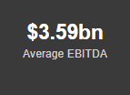
FINANCIAL REPORT
Based on analyse report, Market Capitalization is the total value of the company’s outstanding shares in the stock market, it is calculated by multiply the current stock price by the total number of shares outstanding.
The Total Market Capitalization is $24.87trillion Dollars at an average of $49.24billion Dollars market capitalization value.
This means $49.24billion Dollars is the average value is used determine the benchmark or reference point evaluate individual companies or sectors.
Based on analyse report,
The Total EBITDA is $1.81trillion Dollars at an average of $3.59billion Dollars of EBITDA.
EBITDA means Earning Before interest, Taxes, Depreciation, and Amortization is a financial metric used to evaluate a company’s core probability and performance
If the average value EBITDA is $3.59billion dollars this indicate fair value of weak probability or high operating expenses among sectors.

Slide 9
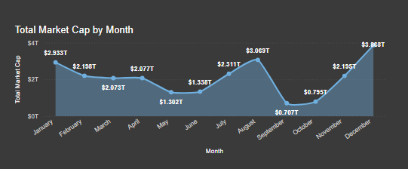
FINANCIAL REPORT
This graph depicts a monthly trend of the Total Market Capitalization.
For further explanations, stock date was not provided, we needed create a period when shares are bought or sold by various investor across each sectors.
I create a dummy stock date spanning Y2022 to Y2024 visualize trend pattern.
The month spanned from November to December 2022 to January to August 2024.
The Total Market Capitalization is $24.87trillion Dollars.

Slide 10
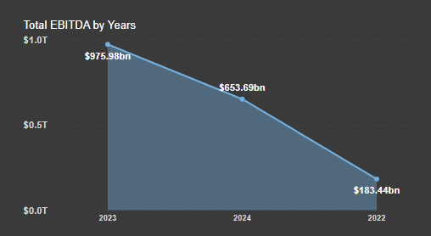
FINANCIAL REPORT
This graph depicts a monthly trend of the Total EBITDA.
The depicts Y2023 has the highest total EBItDA , Y2024.
There is sharp increase from of Total EBITDA Y2023 to Y2022

Slide 11
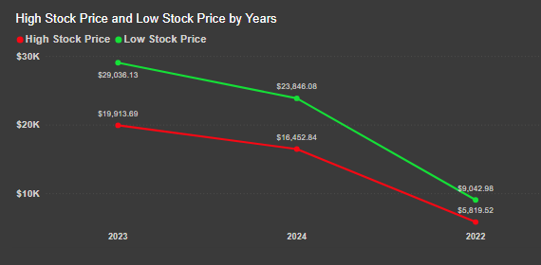
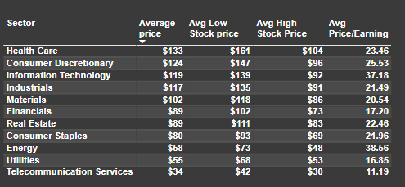
FINANCIAL REPORT
This trend charts depict the equilibrium of Low stock price and the High stock Price over the years
For the Y2023 to Y2023 in low stock price is higher volume of trade compared High stock price.
This table summary the average price , average price/Earning as a dependent indicator from the highest value to lower values

Slide 12
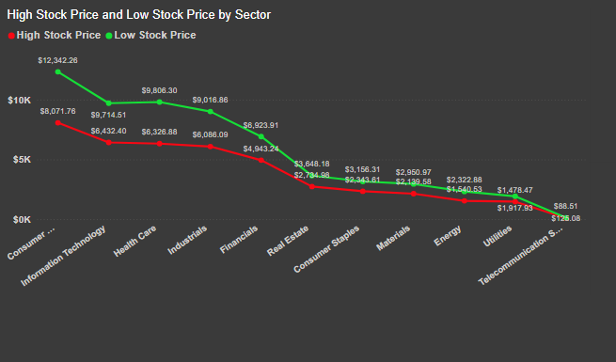
FINANCIAL REPORT
This trend charts depict the equilibrium of Low stock price and the High stock Price across the sector.
The consumer stapler in sector has the highest low stock price compared to High stock price.

Slide 13
CONCLUSION
Those who can make wise investments in the stock market include those who:
Learn about the risks and dynamics of the market.
2. Specify your risk tolerance and financial objectives.
3. To reduce risk, diversify your holdings.
4. Make long-term investments rather than rash choices.
5. Maintain awareness while avoiding marketing hype.
6. Take into account obtaining expert advice..
FOOTNOTE: To normalize the data sets and establish a relationship with the data table or create a data model, dummy stock date was created during the data analysis process. To ascertain the pattern of value stock price over time, a dummy stock date must be created for each share that is bought or sold. Market capitalization, EBITDA, low and high stock prices, and market capitalization are the primary independent variables.

Slide 14
RECOMMENDATION
The following are some broad suggestions regarding the stock market:
:1. Diversify your portfolio: Distribute your investments over a range of industries, markets, and regions.
2. Do your research: Keep up to date on business performance, economic conditions, and market trends.
3Take into account index funds or ETFs: Low-cost, diversified options that provide extensive market exposure.
4.Reduce fees, commissions, and taxes in order to keep costs low.
5. Monitor and adjust: Check your portfolio on a regular basis and rebalance as needed.
Several well-liked equities in different Sectors:
Technology: Microsoft (MSFT), Amazon (AMZN), and Apple (AAPL)
Healthcare: Pfizer (PFE), UnitedHealth Group (UNH), Johnson & Johnson (JNJ)
Finance: Visa (V), Mastercard (MA), JPMorgan Chase (JPM) etc.

Slide 15
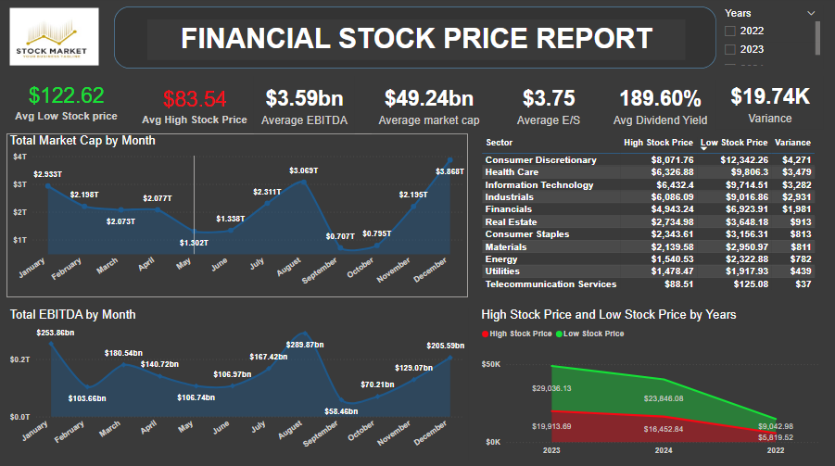
DASHBOARD

Slide 16
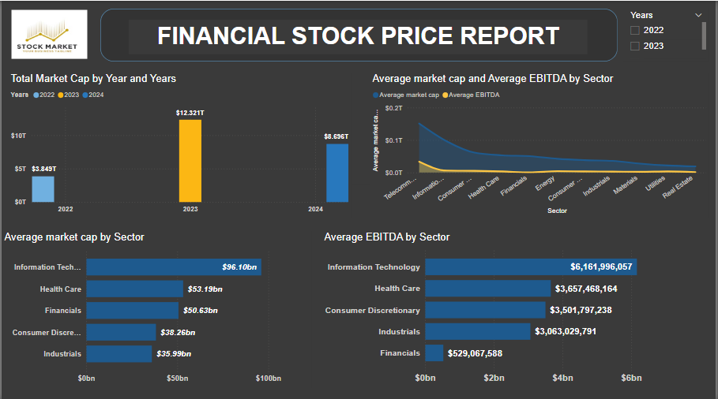
DASHBOARD

Slide 17
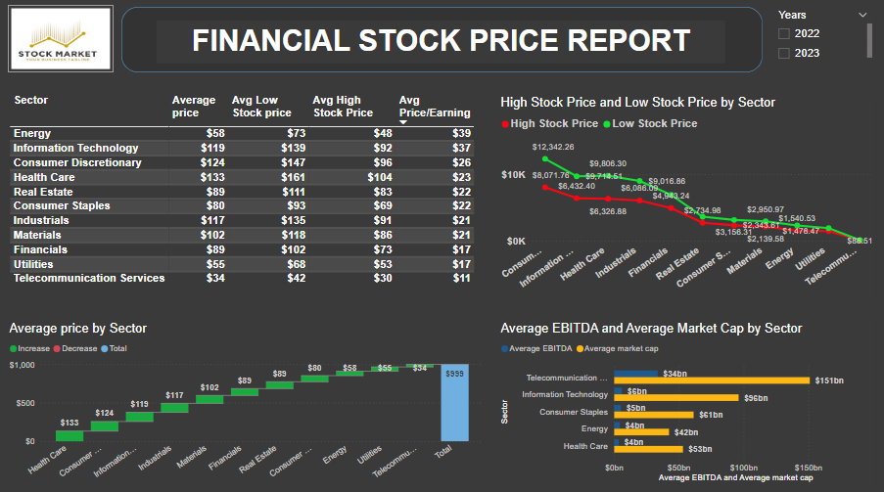
DASHBOARD

Slide 18
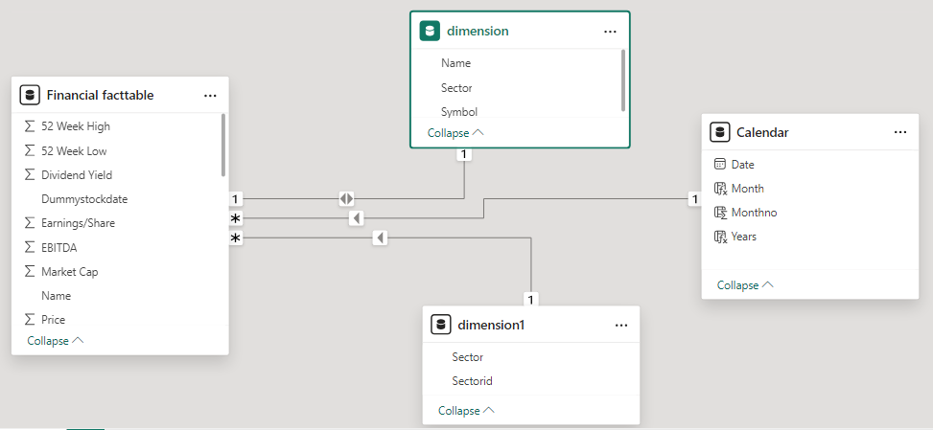
DATA MODEL

Slide 19

THANK
YOU

